Slide 1
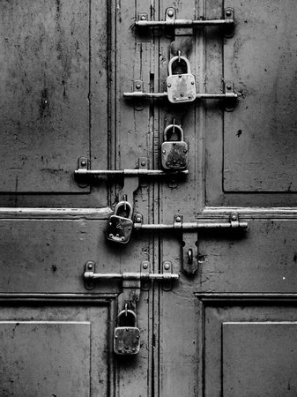
Cybersecurity
Intro to Computer Science
Spring 2018

Slide 2
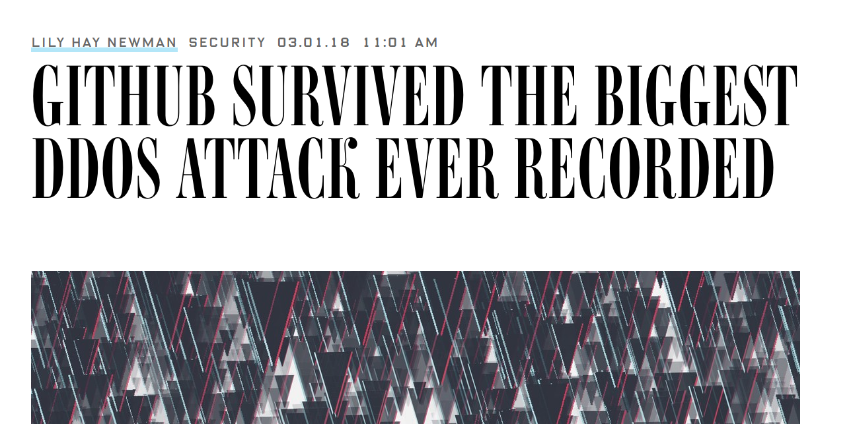
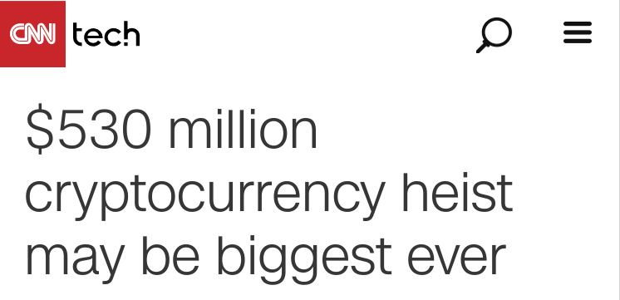
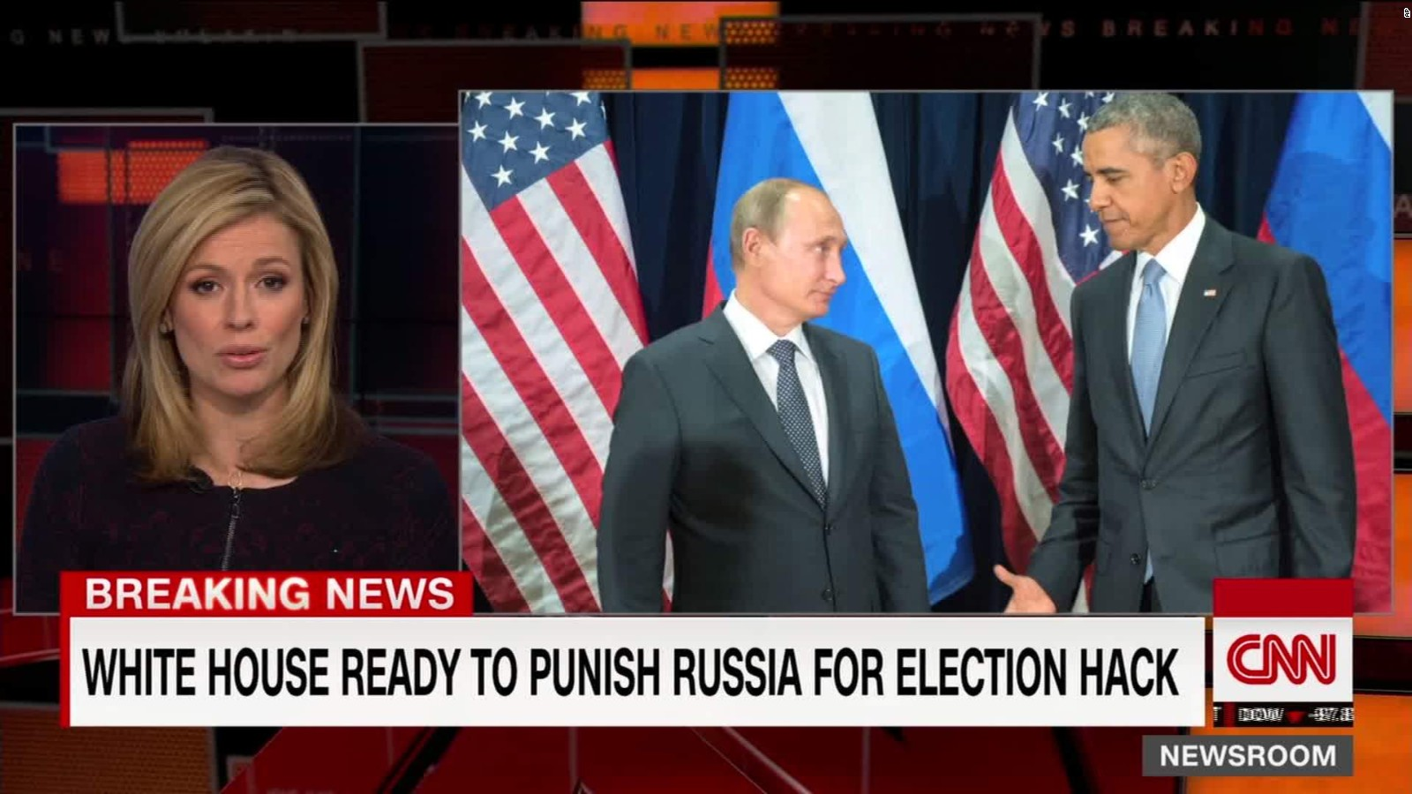
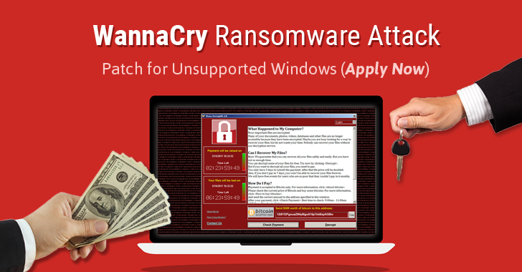
Why is Cybersecurity important?

Slide 3
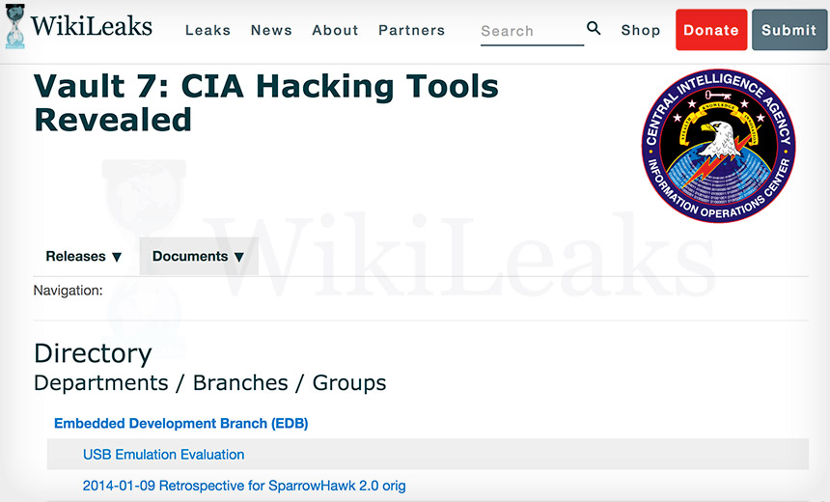
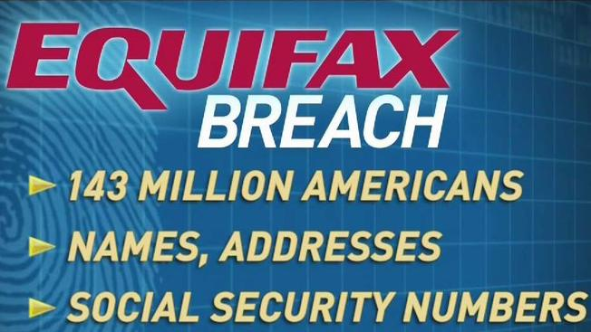

Slide 4
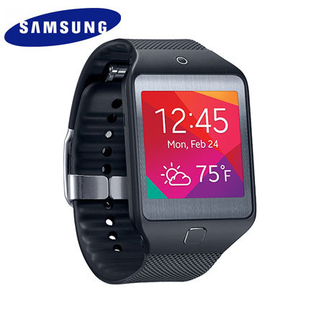
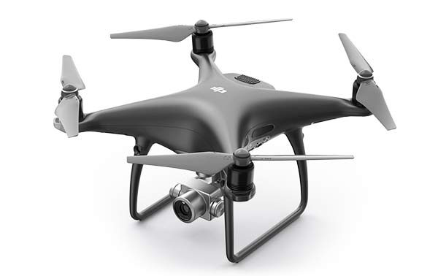
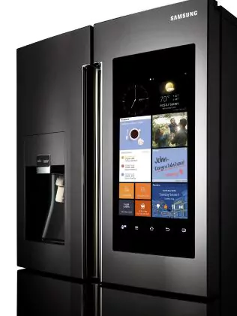
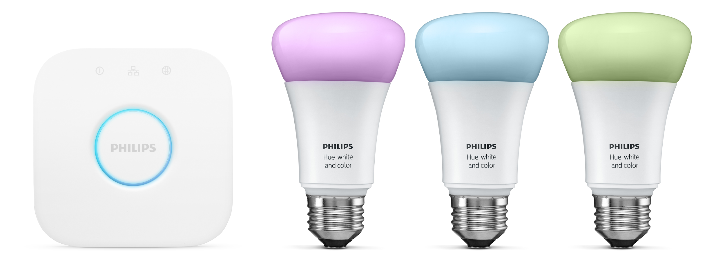
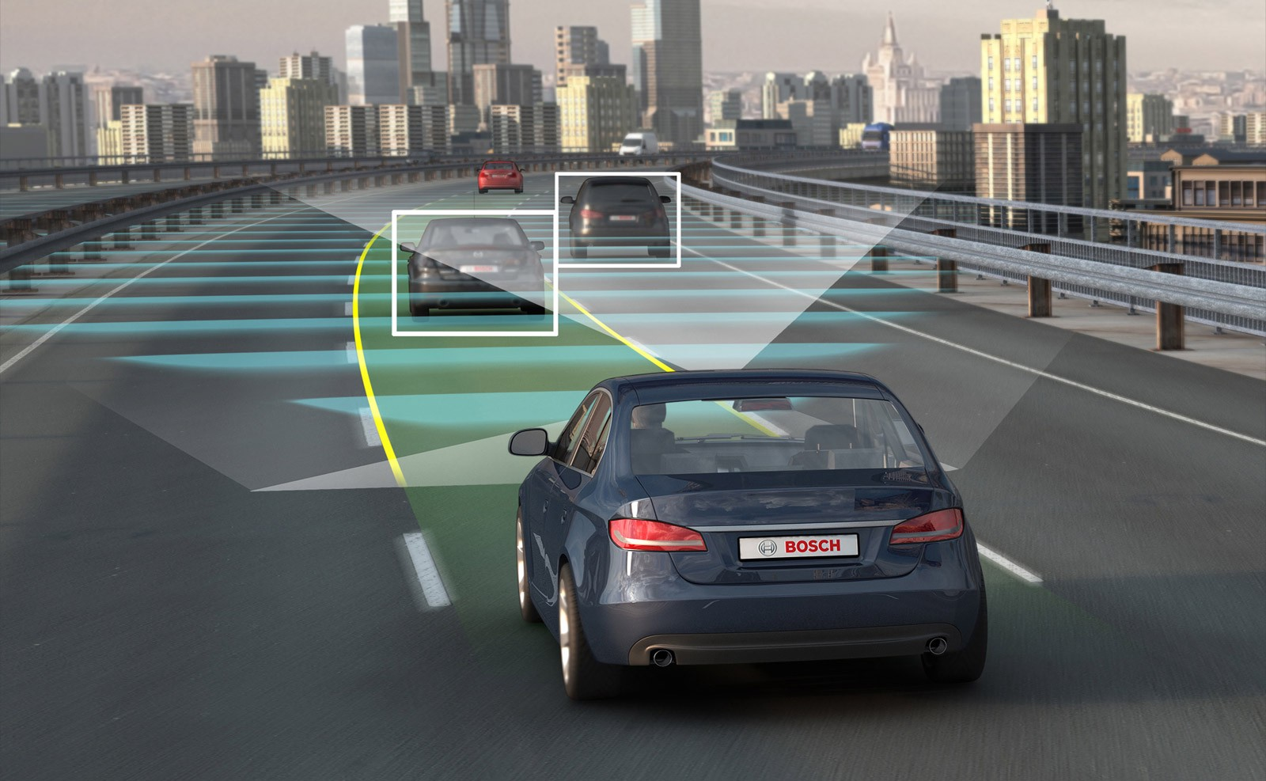
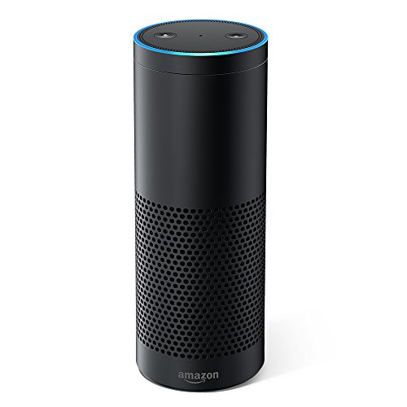
Everything is a computer now

Slide 5
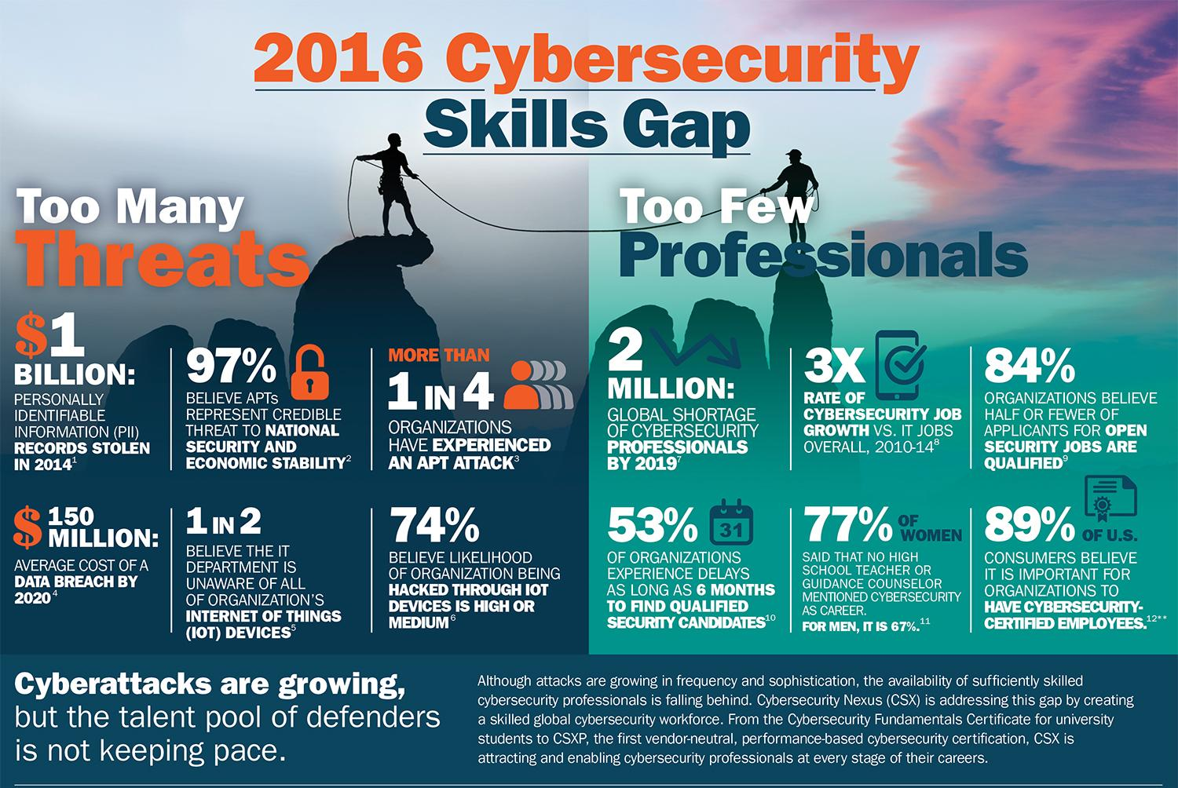

Slide 6
What is security?
Who/What do you trust?
How do you know you can trust them?
What will you do if they break your trust?
Are you willing or able to accept the loss?
Trust
Security
Risk
Notes:
Drugs at a pharmacy, MTA, Neighbor stealing packages, waiter spitting in your food(lmao)

Slide 7
What is security?
What is a risk that you take?
Why do you take that risk?
Is there a circumstance where you will no longer be willing to take that risk?
What measures do you take to mitigate that risk?
Trust
Security
Risk
Notes:
Ask a kid for his wallet

Slide 8

What is security?
Trust and risk are really two sides of the same coin. Together, they represent the state of our security.
If you cannot trust an entity, you take a certain level of risk by allowing use of it.
If you take a risk, you have a level of trust in the entity that you have determined is acceptable.
Security
Trust
Risk

Slide 9
The goal of security is to build trust and minimize risk
Unfortunately, attaining perfect security is very hard (maybe impossible) for a number of reasons:
Attackers will always find a way in. They only need to win once.
New attack surface is always being introduced, creating new vulnerabilities.
The tools and capabilities of attackers outpaces those of defenders
Attackers outnumber defenders… by a lot
We can, however, achieve a reasonable (relative) level of security by making the lives of attackers as difficult as possible.
It may be possible to compromise a system, but we can make it so that the amount of effort required will make an attacker want to give up.

Slide 10
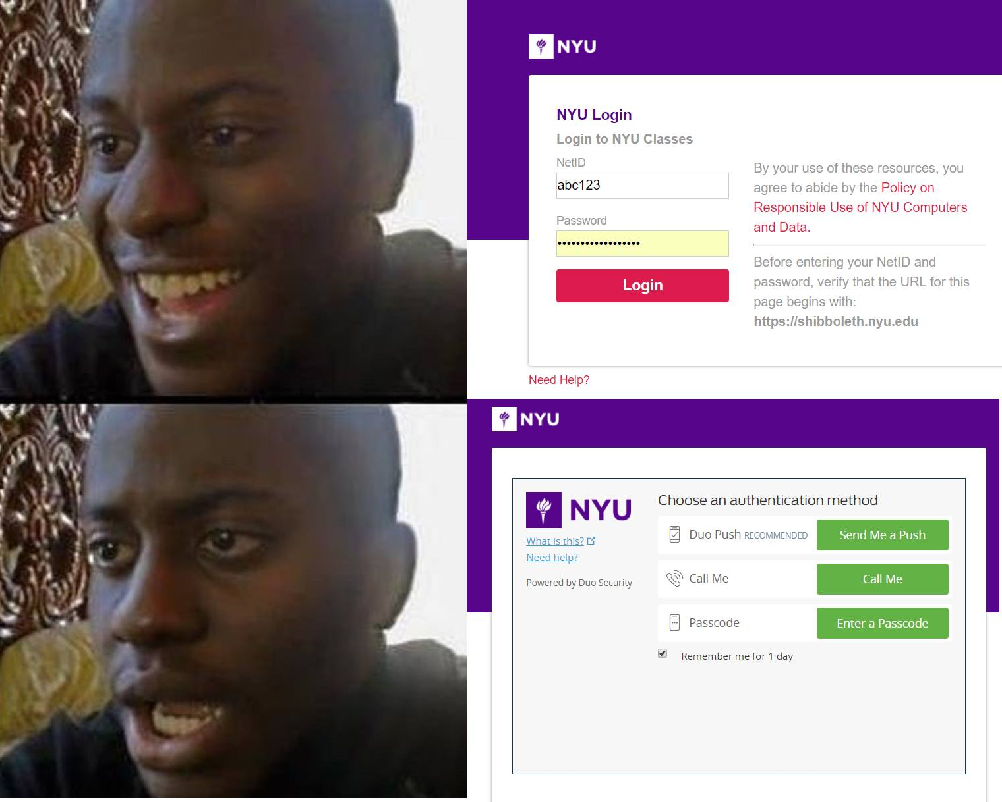
Security over everything? Not quite.
Is there a such thing as being too secure?
When can too much security be a bad thing?
Often times, security can get in the way of getting things done. We have to find the balance.
Usability
Security

Slide 11
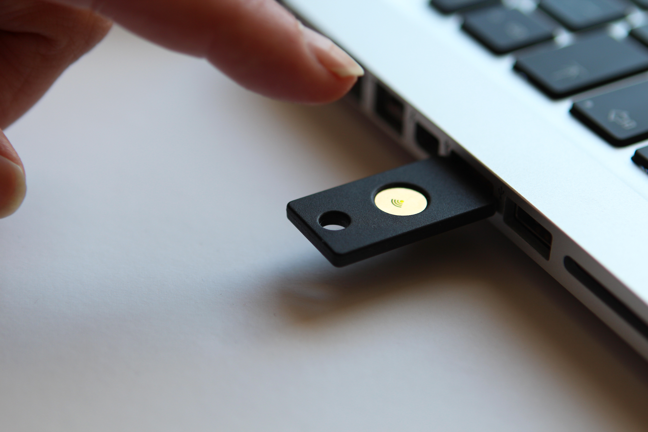
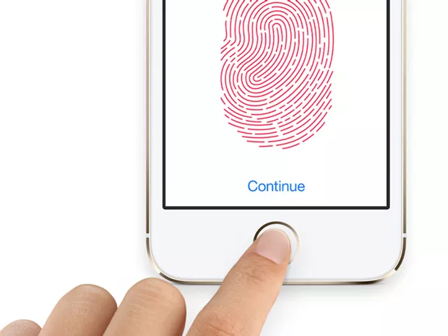
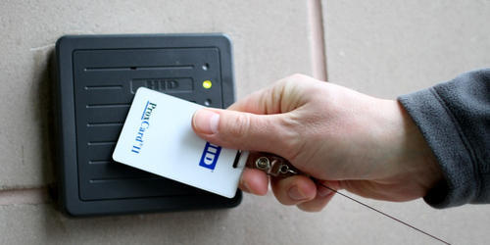
Finding the balance between security and usability
Users are the most important part of any system.
If users are unable to utilize the system, the value is decreased. In most cases, the value of a system is the priority. This usually translates to: “what makes us the most money?”
Ex: A nightclub will not be very
successful if you build it on an
island fortress surrounded by
electric fences and sharks

Slide 12
What are we trying to protect?
Confidentiality
Integrity
Availability
prevention of unauthorized disclosure of information
prevention of unauthorized modification of information
ability to withstand unauthorized withholding of information or resources
Examples?

Slide 13
Other issues in security
Accountability
Reliability
Access Control
Authentication
Non-repudiation
Privacy

